Slide 1
THE BENEFITS OF YOUR 401(K) PLAN
ADP TotalSource Retirement Savings Plan
422479_0526
CN4028295_1126
Notes:
Hello, my name is ______________ (a registered representative of Voya Financial Partners, LLC.) and I will be the host of this presentation. I think we all realize that it has become our responsibility, more now than ever, to prepare for retirement. To reach our goals, it is helpful to have a plan just like the ADP TotalSource Retirement Saving Plan, which is a 401(k) offered to you through your employer.
This presentation will provide you will high level overview of this plan and should give you the information and education about your own account. Now, while this presentation will cover a lot of material, some rules may be specific to your own employer, therefore a review of your employer’s Plan Highlights is suggested as well.

Slide 2
DISCLOSURE
Registered representative and retirement educational seminars are provided by Voya Financial Partners, LLC (VFP). These educational seminars are provided to you as a supplemental service to your plan sponsor as part of the Plan Administrative services provided by Voya Institutional Plan Services, LLC (VIPS). The information contained herein should not be construed as (i) an offer to sell or solicitation of an offer to buy any security or (ii) a recommendation as to the advisability of investing in, purchasing or selling any security. You should contact your investment representative (or advisor), attorney, accountant or tax advisor, with regard to your individual situation prior to implementing a retirement plan strategy.
Notes:
Before we begin, please take a moment to read this important disclosure.
Registered representative and retirement educational seminars are provided by Voya Financial Partners, LLC (VFP). These educational seminars are provided to you as a supplemental service to your plan sponsor as part of the Plan Administrative services provided by Voya Institutional Plan Services, LLC. The information contained herein should not be construed as (i) an offer to sell or solicitation of an offer to buy any security or (ii) a recommendation as to the advisability of investing in, purchasing or selling any security. You should contact your investment representative (or advisor), attorney, accountant or tax advisor, with regard to your individual situation prior to implementing a retirement plan strategy.

Slide 3

AGENDA
01
Goals
02
Saving
03
Investing
04
Resources
Notes:
To understand your retirement plan, you should put some thought behind why you need it and develop a strategy on how to use it. Having a plan may increase the likelihood of reaching your goals. Before you make your elections today or in the future, think about the impact those elections could have both today and in the future.
Your strategy should include:
Establishing your retirement goals,
Determining how to save,
Choosing your investments, and
Using the resources available to you.
Some of you may already feel confident with your choices while others may need more help.
Either way, I will tell you what you need to know and if needed, I will point you in the direction of those that can help.

Slide 4
GOALS
01
Notes:
When I speak about saving for retirement, far too many people simply ask “Why should I have a plan?” And a lot of people have excuses for why they don’t. However, the reasons why most people should save are plenty. There’s an important factor to keep in mind as you think about your savings, and that’s how many years your retirement money will have to last.

Slide 5

Retirement goals
Today, the average 65 year old can expect to celebrate their 84th birthday.*
Your retirement money might have to last 20…30…maybe even 40 years – or more!
What if you make it to a centennial celebration?
Strive to be “on track” with an income replacement of 70% or more.
*National Center for Health Statistics Data Brief, 2019
Notes:
Today, the average 65-year-old can expect to live another 19½ years. [Source: National Center for Health Statistics Data Brief, 2019 – not spoken in recording]
With a healthy lifestyle and a little luck, you might live long enough to blow out a hundred candles on a future birthday cake!
In order to avoid outliving your savings, you should plan on saving enough money to provide retirement income for at least 20 to 30 years. Perhaps 40 years. Hey, maybe more! It depends on when you retire and a host of other factors, some of which you can’t control. The point is, you don’t want income gaps to occur later in life. So give yourself a longevity cushion.
So…how much do you need to save for retirement? How does that number translate into potential monthly income? Are you on track?
In general, you need to replace the income you had during your working years with income from what you have saved for retirement – that’s called income replacement. And most people are considered “on track” if their income replacement is 70% or more. A little later, I’ll tell you how the myOrangeMoney interactive online experience can help you determine if you are on track or not.

Slide 6

Retirement goals
Put thought into your future
Retirement age
Retirement lifestyle
Retirement income
Other assets and benefits
Notes:
When you think about your goals, put some thought into your future. Think about at what age can you realistically retire? What lifestyle would you like to lead? How much income will you need? It is also important to take an inventory of any other retirement assets and benefits.
Of course, all of this doesn’t have to be done right now, but it is a process that should be thought about. Fortunately, this plan allows you to make changes almost as often as you need. And as you will learn, there are many tools and resources that will be available to help you plan for your future.

Slide 7

Stat slide
How much should you save?
Aim to be saving about
10-15%
of your pre-tax income.
Notes:
Saving more is one of the best ways to build up your retirement savings. Professionals advise that you should aim to save 10-15% of your pre-tax income each year. [which includes any employer match.]
Keep in mind that your personal target savings rate may vary depending on a variety of factors, including when you plan to retire, your retirement lifestyle, when you started saving, and how much you've already saved.
If 10-15% feels out of reach, remember — just save as much as you can. Every dollar saved will help.

Slide 8
SAVING
02
Notes:
We will now discuss saving in the plan and the different options and features that are available.

Slide 9
Money in
Pre-tax contributions
Catch-up contributions
  Made before taxes are deducted
  Reduce taxable income
  Growth is tax-deferred
  Taxes paid when you take a distribution
  Made either pre-tax or Roth
  Must be 50 or older by the close of calendar year
  Growth is tax-deferred
  Annual IRS Limit = $8,000
  If you are ages 60, 61, 62, and 63, the total 2025 IRS annual catch-up contributions limit to the Plan is $11,250 (instead of $8,000).
roth contributions
  Made after taxes are deducted
  Does not reduce taxable income
  Growth is tax-deferred
  Potential tax-free distribution¹
Annual irs limit = $24,500
¹ Qualified tax-free distributions on the earnings from Roth occur after the participant reaches age 59½ OR on account of the participant’s death or disability AND after the participant has held the account for at least five years.
Notes:
The ADP TotalSource Retirement Savings Plan will not only ask how much you want to save, you will need to know what type of savings is right for you. In this Plan you have to the ability to save on a Pre-tax or Roth after tax basis. Now, it doesn’t have to be one way or the other, it could be a combination of both. Let’s discuss the two savings options.
Pre-tax contributions are the way we have been saving to 401(k) plans for decades. These contributions come directly out of your check but are taken before-taxes are calculated, thus lowering your taxable income. As you invest your contributions, the potential growth is tax-deferred. However, when it comes time to take the money out, taxes will be paid on your contributions and any earnings.
Roth 401(k) contributions allow you to save in a different way. The contributions still come out of your check and are deposited into the same 401(k) plan, the difference is the contribution are made after-taxes. This means the contribution will be taken from your check after taxes have been calculated, therefore they will not reduce your taxable income. Just as with pre-tax contributions, potential growth is tax-deferred. The biggest difference, qualified distributions are generally Federal income tax free. You pay no taxes on contributions and any related earnings. For a distribution to be qualified it must occur after you reach the age of 59½ and after you have held the account for at least five years.
For individuals that will be 50 years of age or older by years end, you can make catch-up contributions. This allows you to make additional contributions on top of your regular contributions, as shown on the slide.
¹ Qualified tax-free distributions on the earnings from a Roth 401(k) occur after the participant reaches age 59½ OR on account of the participant’s death or disability, AND after the participant has held the account for at least five years.

Slide 10
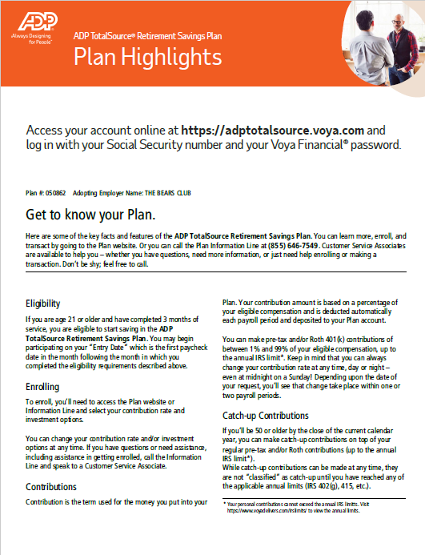
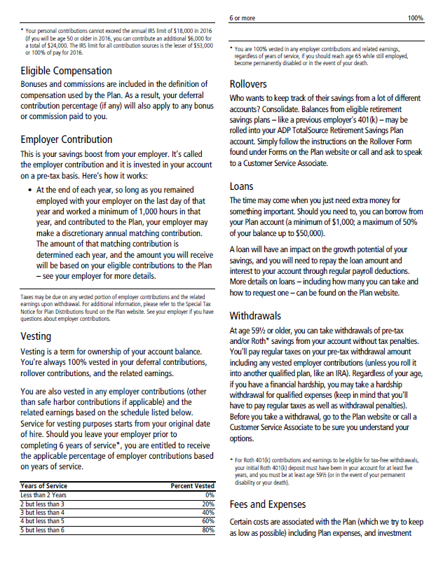
Plan highlights
About your plan
Eligibility
Enrollment
Employer Contributions
Vesting
Rollovers
Notes:
Review Plan specific features by reviewing plan highlights.

Slide 11
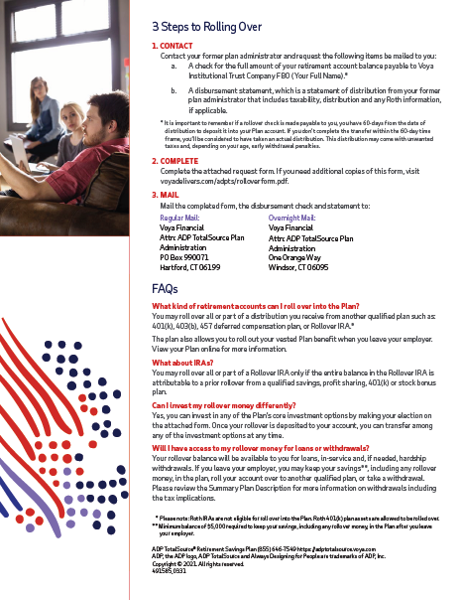
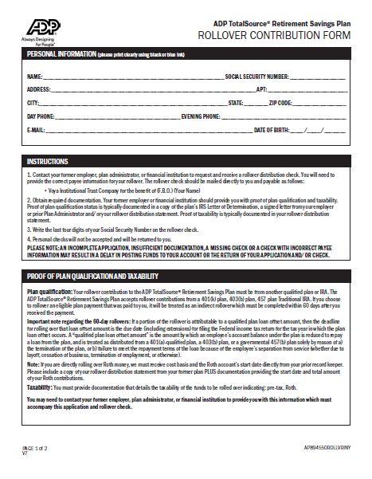

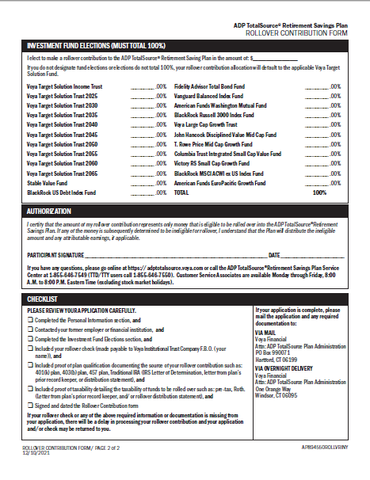

CONSIDERING A ROLLOVER?
Scan here to obtain form.
Notes:
Are you considering a rollover into the ADP TotalSource Plan as the Plan does accept rollovers? It is important to review all of your options, including but not limited to:
managing separate accounts versus account consolidation,
fees
investments offerings and
available services.
You can find the step-by-step instructions and the form on the Participant Resources website, on the Forms section. You do not need a login or password to access this resource website.
Also, if you need assistance, you can call the Voya customer service center and ask for help.
Direct link - https://presents.voya.com/Content/Delivers/adp/presentationresources/adpts_rolloverform.pdf

Slide 12
INVESTING
03
Notes:
We will now discuss some basic investment concepts, the options available in the Plan, as well as options on how to choose your investments.

Slide 13



INVESTING FUNDAMENTALS
ASSET CLASSES
RISK TOLERANCE & TIME HORIZON
ASSET ALLOCATION VS. DIVERSIFICATION
Notes:
Believe it or not, much of investing can be boiled down to just three key elements.
First, are what are known as the asset classes. Asset classes are things of value in the investing world and they each behave differently. Generally, there are three primary asset classes to focus on: stocks, bonds and stable value investments.
Stocks are purchased shares of ownership in a publicly traded company.
Bonds are fixed income investments that represent I.O.U.s issued by governments, municipalities or corporations with the promise of a return of principal and interest.
A stable value investment is commonly an investment in a stable value fund or money market account. These investments are generally considered conservative and low risk.
Most investment funds are made up of a variety of these asset classes.
The second concept is risk tolerance and time horizon. Your comfort level towards risk impacts your investment plan and the types of investments you choose. And time horizon is just that – the amount of time you have until you will need the money you are investing. Time is an important consideration in how you invest.
And the third is asset allocation versus diversification. While some investors think these terms mean the same thing there are differences. Understanding the differences can help you manage your investments.
Let’s review these concepts a little bit more.

Slide 14
INVESTING FUNDAMENTALS
Asset classes and diversification
Stocks
Bonds
Companies
Industries
Countries
Stock mutual funds
Government bonds
Corporate bonds
Bond mutual funds
Stable Value
CDs, treasury bills
Money market funds
Stable value funds
Using diversification as part of your investment strategy neither assures nor guarantees better performance and cannot protect against loss in declining markets.
Notes:
You ae looking the three primary asset classes discussed early. However, you can now see how those asset classes can represent different types of investments.
How you spread your money across the investments within each of the asset classes is called diversification. When you diversify, you spread your risk. Keep in mind that you are always at risk, no matter what you do, but with this approach you may reduce the likelihood that all your investments decline at once.
By investing in different industries, companies, sizes of companies, and countries within the stock asset class, for example, you improve the chances for growth because your savings won’t rely on any one stock. Within the bond and stable value asset class, you can invest in different types of bonds or cash-like instruments.
Bear in mind that diversification does not guarantee a profit or protect against loss in a declining market.
Your goal is to find the right mix of investments for your particular situation. It largely depends on how much time you have and how you feel about risk.

Slide 15
Investing fundamentals
Asset allocation
Find the right mix among the three asset classes.
Longer time horizon
Shorter time horizon
5% Stocks
35% Bonds
60% Stocks
25% Stable Value
5% Stable Value
70% Bonds
Using asset allocation as part of your investment strategy neither assures nor guarantees better performance and cannot protect against loss in declining markets. These hypothetical portfolios are for illustrative purposes only and not a recommendation of a specific asset allocation strategy.
Notes:
With investing, it’s all about finding the right mix for your particular situation. How you divide your money among the “asset classes” is known as asset allocation, or your investment mix. In other words, what percentage of stocks will you have? Bonds? What percentage of stable value?
Let’s take a closer look at asset allocation and how much you might allocate to each asset class – depending on your age.
Someone who has more until retirement may have an asset allocation of: 60% stocks, 35% bonds and 5% stable value
And someone who has less time until retirement may have an asset allocation of: 5% stocks, 70% bonds and 25% stable value
Properly managing your asset allocation and diversifying within those asset classes is an important strategy that is need to assist in achieving your goals at a risk level to which you are comfortable.

Slide 16
TARGET DATE FUND INVESTING
Manage risk tolerance and time horizon
How target date funds are adjusted over time as each portfolio becomes more conservative.
More aggressive
More conservative
Initially the portfolio will include a mix of more aggressive funds.
Some money is gradually shifted out of more aggressive funds and into more income-oriented funds.
More is allocated to stability of principal funds.
Stable Value
Bonds
Stocks
Notes:
Choosing a mix of investments that meets your timeline and your tolerance for risk can be complicated. Therefore, if you are managing your investments yourself be sure to review from time to time. However, there is an alternative to consider - target date funds.
If you are someone that does not feel comfortable making investment decisions or you don’t have the time or confidence in managing your own account, a target date fund may be the option for you. These funds are a diversified collection of investments put together and managed for you and people like you, based on the year you expect to start using this money and for most people that would be retirement. If you were 40 in 2023 and planned on retiring at 65, that would mean you wanted to retire in the year of 2048. With that goal in mind, you should consider the target date fund closest to that year.
These funds are designed to invest at a risk level that is suitable given how close or far from retirement you are. Also, as time passes these funds will automatically and gradually shift to become a more conservative investment.
It is also important to point out that you can use any of these funds you want regardless of your age. You can choose more than one or in conjunction with any of the other investments in the Plan. You also have the ability to move out of these investments at anytime.

Slide 17




Choosing your investments
Guide me
Give me advice
Choose from pre-diversified mix of investments
Have a professional take the lead
Get there myself
Self-directed brokerage account
Choose your own investment mix
Experienced investor to buy and sell individual securities
Notes:
Now that we’ve reviewed some investment fundamentals, let’s talk about the options available to you in the ADP TotalSource Retirement Savings Plan.
Since everyone has a different approach to investing, the Plan offers four options to fit your level of experience, knowledge, and interest.
With the Guide Me option, you choose a Target Date fund and then let the fund do the investment work for you. Each Target Date fund is a pre-diversified mix of investments, managed by a professional fund manager, who automatically adjusts the risk and return exposure of the fund as you get closer to retirement.
The Get There Myself option provides you with all of the Plan’s core funds to choose from. These include stock, bond, and stable value investments. You pick the funds you want to invest in and create a strategy that you think will best fit your time horizon and risk tolerance. Then you manage your portfolio of funds over time.
If you like getting savings and investment advice tailored to your personal situation, Voya Retirement Advisors, powered by Edelman Financial Engines, provides you with two levels of service – Online Advice and Professional Management.
If you are confident with an independent approach to actively managing your retirement assets you’ve invested in the Plan, then the Self-Directed Brokerage Account option may be right for you. A Self-Directed Brokerage Account is designed for the experienced investor who wants to independently and actively manage an even greater choice of investments and is willing to pay additional fees and accept full responsibility for researching, selecting, monitoring and managing their investments. For more information on this option, please review the Self-Directed Brokerage Account Participant Guide – it’s a detailed guide that walks you through self-directed brokerage accounts; and it can be found on the Participant Resources website.
For more information about the funds, including historical performance, fund fact sheets, and more, go to the Plan website and select the Investments & Research tab. You should read all fund information made available to you before making any investment decisions.

Slide 18

Your target date fund options
Target Date Trusts
Voya Target Solutions Income Trust
Voya Target Solutions 2030 Trust
Voya Target Solutions 2035 Trust
Voya Target Solutions 2040 Trust
Voya Target Solutions 2045 Trust
Voya Target Solutions 2050 Trust
Voya Target Solutions 2055 Trust
Voya Target Solutions 2060 Trust
Voya Target Solutions 2065 Trust
Voya Target Solutions 2070 Trust
Notes:
Here are the target date fund options available to you in the ADP TotalSource Retirement Savings Plan.
For more information about these options, including historical performance, fund fact sheets, and more, go to the Plan website and select the Fund Information menu. You should read all fund information made available to you before investing.

Slide 19
DISCLOSURE
The Target Solution Trust principal risks are generally those attributable to investing in stocks, bonds and related derivative instruments. Target Solution Trust holdings are subject to market, issuer and other risks, and their values may fluctuate. Market risk is the risk that securities or other instruments may decline in value due to factors affecting the securities markets or particular industries. Issuer risk is the risk that the value of a security or instrument may decline for reasons specific to the issuer, such as changes in its financial condition. Additionally, the concentration of Target Solution Trust holdings may lead to high volatility and tracking error relative to the benchmark. Furthermore, there is the risk that needed hedges may not always be available in the derivatives markets or available at attractive prices. In addition, because each Target Solution Trust is exposed to underlying collective funds, the performance of these investment vehicles will have a substantial impact on the Target Solution Trust’s overall performance, and such investment vehicles may have unique risks based on their strategy and operations. Certain underlying investment vehicles may not offer daily liquidity. The Target Solution Trust may also incur fees attributable to such underlying pooled investment vehicles. In some situations, fees paid from these investment vehicles to affiliates of the Trustee may be offset or rebated vis-a-vis the Trust or its investors.
There is no guarantee that any investment option will achieve its stated objective. Principal value fluctuates and there is no guarantee of value at any time, including the target date. The “target date” is the approximate date when an investor plans to start withdrawing their money. When the target date is reached, the investor may have more or less than the original amount invested. For each target-date portfolio, until the day prior to its target date, the portfolio will seek to provide total returns consistent with an asset allocation targeted for an investor who is retiring in approximately each portfolio’s designated target year. On the target date, the portfolio will seek to provide a combination of total return and stability of principal.
Notes:
Before we begin, please take a moment to read this important disclosure.
Registered representative and retirement educational seminars are provided by Voya Financial Partners, LLC (VFP). These educational seminars are provided to you as a supplemental service to your plan sponsor as part of the Plan Administrative services provided by Voya Institutional Plan Services, LLC. The information contained herein should not be construed as (i) an offer to sell or solicitation of an offer to buy any security or (ii) a recommendation as to the advisability of investing in, purchasing or selling any security. You should contact your investment representative (or advisor), attorney, accountant or tax advisor, with regard to your individual situation prior to implementing a retirement plan strategy.

Slide 20
Your investment options
Stocks
Vanguard Balanced Index
American Funds Washington Mutual
BlackRock Russell 3000 Index
American Century US Premier Large Cap Growth Trust
John Hancock Disciplined Value Mid Cap
T. Rowe Price Mid Cap Growth
DFA US Small Cap Value
Neuberger Berman Small Cap Growth II CIT
BlackRock MSCI ACWI Ex-US Index
American Funds EuroPacific Growth
Bonds
BlackRock U.S. Debt Index
Fidelity Advisor® Total Bond
Stable Value
Stable Value
Notes:
Here are the individual fund options available to you in the ADP TotalSource Retirement Savings Plan.
For more information about these options, including historical performance, fund fact sheets, and more, go to the Plan website and select the Fund Information menu. You should read all fund information made available to you before investing.

Slide 21
Give me advice
Online advice
Professional management
Unlimited access to powerful online retirement planning tools (at no additional cost to you)
Designed for people who enjoy actively managing their own retirement account
A personalized plan and VRA Investment Advisor representatives to talk to
Ideal for people who want VRA to manage their retirement account (for a monthly fee)
IMPORTANT: Forecasts regarding the likelihood of various retirement income and/or investment outcomes are hypothetical in nature, do not reflect actual results (including investment results) and are not guarantees of future results. Results may vary with each use and over time.
Notes:
I mentioned a minute ago that your Plan gives you access to investment advisory services offered through Voya Retirement Advisors, LLC (VRA) and powered by Edelman Financial Engines. The service:
Will provide you with a realistic forecast of your chance of reaching your retirement income goals,
And will provide specific savings and fund recommendations to help improve your chance of potentially reaching your goals
Online Advice is a web-based service for investors seeking advice to help make their own decisions. Based on users input, the Online Advice tool will display a retirement forecast of their current choices, investment and saving recommendations and is available to all Plan participants at no additional cost.
Professional Management is a service designed for the investor, who would rather have investment professionals pro-actively manage their retirement savings Plan. The service will provide ongoing assessments of your progress, automatic updates to keep you on target, it will personalize your profile and provide periodic account optimization and progress reports. Ongoing delivery of this service does require a monthly fee.
IMPORTANT: Forecasts regarding the likelihood of various retirement income and/or investment outcomes are hypothetical in nature, do not reflect actual results (including investment results) and are not guarantees of future results. Results may vary with each use and over time.

Slide 22
DISCLOSURE
Advisory Services provided by Voya Retirement Advisors, LLC (VRA). VRA is a member of the Voya Financial (Voya) family of companies. For more information, please read the Voya Retirement Advisors Disclosure Statement, Advisory Services Agreement and your plan’s Fact Sheet. These documents may be viewed online by accessing the advisory services link(s) through your plan’s website. You may also request these from a VRA Investment Advisor Representative by calling your plan’s information line. Financial Engines Advisors L.L.C. (FEA) acts as a sub advisor for Voya Retirement Advisors, LLC. Financial Engines Advisors L.L.C. (FEA) is a federally registered investment advisor. Neither VRA nor FEA provides tax or legal advice. If you need tax advice, consult your accountant or if you need legal advice consult your lawyer. Future results are not guaranteed by VRA, FEA or any other party and past performance is no guarantee of future results. Edelman Financial Engines® is a registered trademark of Edelman Financial Engines, LLC. All other marks are the exclusive property of their respective owners. FEA and Edelman Financial Engines, LLC are not members of the Voya family of companies. ©2025 Edelman Financial Engines, LLC. Used with permission.
Schwab Personal Choice Retirement Account® (PCRA) is offered through Charles Schwab & Co., Inc. (Member SIPC), the registered broker/dealer, which also provides other brokerage and custody services to its customers. ©2025 Charles Schwab & Co., Inc., (Member SIPC). All rights reserved.
Charles Schwab & Co., Inc. and Voya Financial are not affiliated and are not responsible for the products and services provided by the other.
Notes:
Please take a moment to review this important disclosure relating to advisory services.

Slide 23
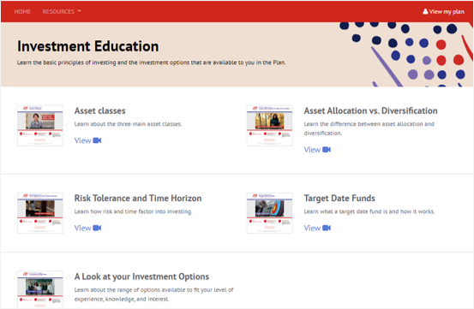

Investment education resources
Scan here to learn more.
Notes:
To continue your investment education, visit your investment education resource site. On this page you can view:
Investment educational videos,
Fund fact sheets,
Self-directed brokerage information and
Fee disclosure.
Direct link: https://presents.voya.com/Content/Delivers/adp/fund-information.php

Slide 24
RESOURCES
04
Notes:
ADP TotalSource and Voya offer many tools and resources that can assist you in managing your Plan account. Let’s go over a few of them.

Slide 25

Stat slide
Managing your account
WEB
Visit the Associate Portal and log in with your username and password. Then click the Myself tab and select Retirement Plan under Benefits.
Or log in to the Plan website at https://adptotalsource.voya.com
MOBILE
Search ADP Mobile App or Voya Retire in your preferred mobile app store.
PHONE
Call the Plan Service Center at (855) 646-7549 and press 0 to speak with a Customer Service Associate.
Notes:
A big part of your relationship with the ADP TotalSource Retirement Savings Plan is how you will be able to manage your account on an ongoing basis. We will give you access to your account three different ways, online, through a mobile device, or over the telephone.
Through your mobile device you can utilize the Voya Retire App or the ADP Mobile Solutions App which will not only give you your account balance but will provide you functionality, such as changing your contribution or investments.
Access your account through the web by visiting adptotalsource.voya.com. For initial access you will need your social security number and the Voya provided password.
And of course you have telephone access. Dial 855-646-7549 to access your account 24 hours a day, 7 days a week through an automated line or if you prefer to speak with a customer service associate, call between the hours of 8am and 8pm Eastern Time, Monday through Friday excluding stock market holidays.

Slide 26
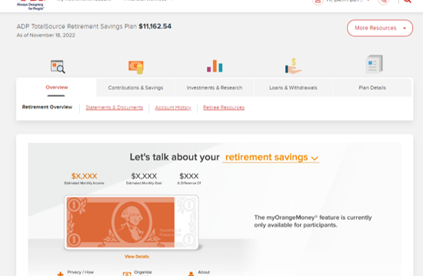
My orange money®
IMPORTANT: The illustrations or other information generated by the calculators are hypothetical in nature, do not reflect actual investment results, and are not guarantees of future results. This information does not serve, either directly or indirectly, as legal, financial or tax advice and you should always consult a qualified professional legal, financial and/or tax advisor when making decisions related to your individual tax situation.
Notes:
Voya prides itself on offering innovative tools and resources to help participants.
myOrangeMoney® is an interactive educational online experience that enables you to visualize and better understand — as soon as you enroll online in the Plan — how the decisions you make with your current retirement assets may translate into potential monthly income in retirement.
[Educator direction – if an animated demo experience is desired use the available pWeb demo]

Slide 27



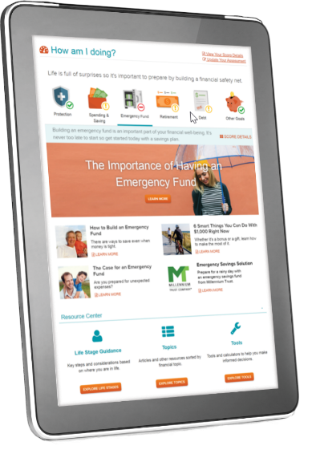



Financial wellness
Holistic financial guidance that helps you address, prioritize and balance key components of financial health.
Notes:
Financial Wellness is a guided education experience. This resource center is a centralized home for all educational materials. Take a brief Financial Wellness Assessment that’s used to score an individual’s financial health across the 6 pillars: protection, spending & saving, emergency funds, retirement, debt and other goals. This all leads to the creation of a personalized Financial Wellness dashboard.

Slide 28

Voya learn
Our innovative educational platform
Watch and learn at
www.voyalearn.com
Topics include:
Personal finance
Retirement and investing
Protection and family
Also available in Spanish
Sign up today
for one of our upcoming live sessions
Watch one of our on-demand videos
Scan here to learn more.
designed to help you achieve the financial future you envision.
Notes:
If you are looking for more resources to help you – visit Voya Learn. There, you’ll have access to our library of live and on demand education on a variety of financial wellness topics including: Retirement planning, Investing, Healthcare expenses and considerations, Government programs, Personal finance and Protection from the unexpected.

Slide 29

Questions or more information
Online
https://adptotalsource.voya.com
Telephone
(855) 646-7549
Mobile Device
ADP Mobile Solutions app
Voya Retire
Notes:
If you have questions or would like to act, please use the plan resources available to you.

Slide 30

congratulations
on taking steps towards investing in your retirement.
Notes:
A 401(k) like the ADP TotalSource Retirement Savings Plan can be an important benefit to help you save to potentially secure your financial future. As you walk along, your retirement income is a journey…know that the ADP TotalSource® Retirement Savings Plan is with you every step of the way.
Thank you for your attention. I hope we helped you better understand this benefit offered by ADP TotalSource.

Slide 31
DISCLOSURE
Today’s webinar was designed to provide you with fundamental information on retirement planning and to outline other sources of information to assist you in managing your personal finances.
This presentation does not constitute legal, investment or financial advice of any kind.
Please consult your own financial, legal and/or tax advisors for such advice.
Notes:
Today’s workshop was designed to provide you with fundamental information on retirement planning and to outline other sources of information to assist you in managing your personal finances
This presentation does not constitute legal, investment or financial advice of any kind
Please consult your own financial, legal and/or tax advisors for such advice

Slide 32
OPTIONAL SLIDES

Slide 33
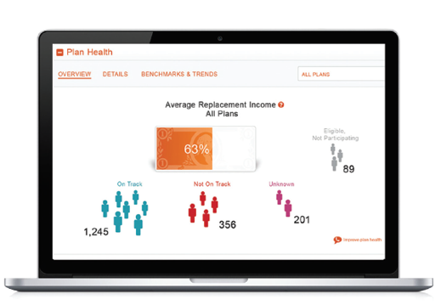
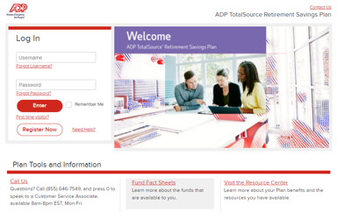

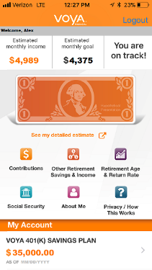


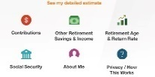
Keep thinking about your future
You can begin to access your account and act.
Your ADP TotalSource Retirement Savings Plan is live!
Enrollment information delivered
30 DAYS PRIOR
~ 2 WEEKS PRIOR
EFFECTIVE DATE
Important documents
Educational content
Timeframes are designed to provide an example of our most common onboarding processes. Each situation can vary and in some instances, timeframes can be significantly different than the example seen in this illustration.
Notes:
[NOTE: Only to be shown when hosting a meeting for a new client]
Understanding what occurs prior to you plan going live is important to your planning.
Approximately 30 days before your plan goes live Enrollment information delivered which includes among other things Important documents and Educational content
Approximately 2 weeks before your plan goes live you can begin to access your account and act.
On your effective day – Your ADP TotalSource Retirement Savings Plan is live!
Be aware timeframes listed are designed to provide an example of our most common onboarding processes. Each situation can vary and in some instances timeframes can be significantly different than the example seen in this illustration.

Slide 34
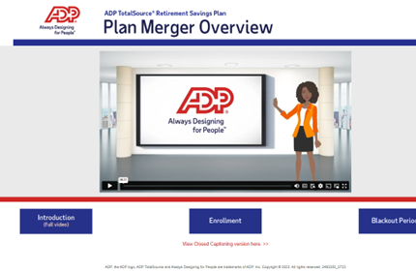

Merging your current plan
Scan here to learn more.
Notes:
[Merger Review OPTION 1 – Play video]
[NOTE: Only to be shown when hosting a meeting for a known merger client]
Since your employer has elected to adopt the ADP TotalSource Retirement Savings Plan and merge your existing 401(k) plan into this plan, I’d like to share a short video about the merger process and what role you play.
PLAY VIDEO - https://presents.voya.com/Content/Delivers/adp/video/adp_merger_enus/

Slide 35
MERGING YOUR CURRENT PLAN
Your ADP TotalSource Retirement Savings Plan is live!
Transition & blackout notice delivered
Assets are transferred from previous recordkeeper
EFFECTIVE DATE
+ 15 DAYS
+ 45 TO 90 DAYS
Merger dates
Fund mapping
Timeframes are designed to provide an example of our most common onboarding processes. Each situation can vary and in some instances, timeframes can be significantly different than the example seen in this illustration.
Notes:
[Merger Review OPTION 2 – GO OVER SLIDE WITH AUDIENCE]
[NOTE: Only to be shown when hosting a meeting for a known merger client]
Here is the merging process timeline. Please review understanding timeframes are estimate and the transition and black out notice will provide specifics.

Slide 36
MAXIMIZE YOUR MATCH
$378,576
$174,131
Employee Contributions
Employer Match Contributions
$61,762
HOW DID WE COME UP WITH THESE NUMBERS?
These numbers are based on a salary of $50,000 with a 5% contribution savings and an employer match formula equal to $1.00 for $1.00 on the first 3% and $0.50 for $1.00 on the next 2%. This example is for illustrative purposes only and is not intended to be investment advice or a prediction of future results. Please refer to your Plan Highlights for your employer’s match formula.
Notes:
[NOTE: Only to be shown if employer offers a match]
Did you know that your employer helps you save for the future by making a match contribution into your Plan account? It’s based on the amount that you save. Your specific match formula can be found in the Enrollment Guide sent to you or on your Plan Highlights.
When it comes to saving for the future, more is definitely better. So be sure to contribute enough to receive the maximum company match.
Let’s take a look at how your company matching contributions add a boost to your retirement savings.

Slide 37


STARTING EARLY MAKES A DIFFERENCE
TOTAL CONTRIBUTIONS
$48,000
From age 25-65, I contributed $100/month
TOTAL SAVINGS
$191,696
+ $55,002
She ends up with more by contributing earlier, even though contributions were less. More time to grow and a good reason to think about starting sooner.
TOTAL SAVINGS
$136,694
From age 45-65, I contributed $300/month
TOTAL CONTRIBUTIONS
$72,000
Assumes each account earns an annual tax-deferred rate of return of 6% compounded monthly. This illustration is hypothetical, is not guaranteed and is not intended to reflect the performance of any specific investment or security. You should consider your financial ability to continue investing consistently in up as well as down markets. In addition, these figures do not reflect taxes or any fees, expenses or charges of any investment product. Taxes are generally due upon withdrawal and early withdrawal penalties may apply to withdrawals taken prior to age 59½. You should consult with a tax advisor or tax attorney prior to implementing tax-based decisions. Legal and tax advice are not offered by Voya Financial and its representatives.
Notes:
[NOTE: Only to be shown if client requests an example of the benefits of starting early]
Why does starting now matter? The longer you save, the more you could potentially have in retirement. How can such a simple idea be so essential? It’s because time is one of the most important factors affecting how much you may end up with in retirement.
When you invest through an employer retirement plan, any potential earnings on your contributions are automatically reinvested. The longer you have to invest, the greater the opportunity for your investments to potentially grow.
The earnings on those investments get reinvested where they have the potential to grow and create more earnings, which get reinvested and on and on. This process is called compounding, and it can be a powerful growth engine for your savings. Of course, systematic investing does not ensure a profit nor guarantee against loss. You should consider your financial ability to continue making contributions through periods of low price levels.

Slide 38
GIVE YOUR SAVINGS A BOOST
Assumes 6% hypothetical rate of return and weekly contributions. This illustration is hypothetical, is not guaranteed, and is not intended to reflect the performance of any specific investment. There is no assurance that increasing contributions will generate investment success. In addition, these figures do not reflect taxes or any fees or charges that may be assessed by the investments. The tax-deferred investment will be subject to taxes on withdrawal. Systematic retirement plan contributions does not ensure a profit nor guarantee against loss.
Notes:
[NOTE: Only to be shown if employer requests an example of the benefits of saving at different dollar amounts]
Give your savings a boost! In this hypothetical example a contribution of $15 per week, you could accumulate to nearly $60,000 in 30 years. Step it up to $35 a week and it could reach
$135,000 or more. The point is, the more steps you take to save, the more potential impact you could have to your retirement savings
Consider the extra savings today a commitment to yourself and your future. Remember, you set the pace. It’s never too early to start saving – and never too late to step it up. This is your plan for retirement, your future. Consider taking new steps today!
This example assumes a 6% hypothetical rate of return and weekly contributions. This illustration is hypothetical, is not guaranteed, and is not intended to reflect the performance of any specific investment. There is on assurance that increasing contributions will generate investment success. In addition, these figures do not reflect taxes or any fees or charges that may be assessed by the investments. The tax-deferred investment will be subject to taxes on withdrawal. Systematic retirement plan contributions does not ensure a profit nor guarantee against loss.

Slide 39
Money OUT
LOANS
WITHDRAWALS
  Up to two loans at one time
  Minimum amount: $1,000
  Maximum amount: 50% of vested balance, no more than $50,000 in a 12-month period
  General and residential Loan schedules
  Interest rate
  Processing Fee
  Hardship
  In-service
DISTRIBUTIONS
  Leave your money in the Plan
  Rollover to another qualified plans (non-taxable until distributed)
  Take a lump-sum payment or receive in installments (taxable distribution)
Loans may impact your withdrawal value and limit participation in future growth potential. Before taking a withdrawal or distribution, you are required to review the IRS Special Tax notice. This notice can be obtained on the Plan’s website or by mail. Voya Financial® does not offer legal or tax advice. Consult with your tax and legal advisors regarding your individual situation. Withdrawals and distributions from the Plan may be subject to 20% federal tax withholding. State tax withholding may also apply. If you are less than age 59½, a 10% premature distribution penalty tax applies unless there is an exception.
Notes:
[NOTE: Only to be shown if employer requests details of loans, withdrawals and distributions]
First, the ADP TotalSource Retirement Savings Plan offers a loan option. You are allowed to have up to 2 loans at one time. In most cases you can borrow up to 50% of your vested account balance, no less than $1,000 and no more than $50,000 in a 12 month period.
This is a loan, therefore you will pay back the principal and interest through payroll deductions. Be aware there is a fee that will be taking from your account when the loan is processed. Although loans can be processed easily, you are temporarily taking money out of your account and you should consider the impact a loan may have on the future value of your account.
Keep in mind, loans may impact your withdrawal value and limit participation in future growth potential.
When talking about taking money out of the account, without having to pay it back, it is important to remember that this is not a savings account. While actively employed, withdrawals are available only in certain circumstances, such as being over the age of 59 ½ or if you find yourself in a financial hardship, something like preventing foreclosure or payment of unreimbursed medical bills. Because the availability of in-service withdrawals are rare and can result in severe tax consequences, you should review your plan with a tax professional.
When you leave the company, your distributions options are more flexible. First of all, you may not have to do anything. If you balance is greater than $5,000 you can of leave your money in the Plan and continue to invest and manage as you did while you were actively employed. If your balance is less than $5,000 you may need to take action and will be informed at the time. Your second option would be to rollover your money to another qualified retirement plan, like another 401(k) or IRA. Finally, you could request a taxable distribution and have us cut a check directly to you, but again since this choice can result in severe tax consequences you should discuss this with a tax professional.
Before taking a withdrawal or distribution you are required to review the IRS Special Tax notice. This notice can be obtained on your Plan’s Web site or by mail. Voya Financial® does not offer legal or tax advice. Consult with your tax and legal advisors regarding your individual situation. Withdrawals and distributions from the Plan may be subject to 20% federal tax withholding. State tax withholding may also apply. If you are less than age 59½, a 10% premature distribution penalty tax applies unless there is an exception.

Slide 40

HOW DOES A TARGET DATE FUND WORK?
A target date fund (TDF) offers diversified investments combined in a single fund option. TDFs are designed for a participant to pick one fund that closely aligns with an individual’s retirement date.
Notes:
[OPTION 1 – SHOW VIDEO if additional information on Target Date funds is requested]
https://presents.voya.com/Content/Delivers/adp/video/adp_target_date_funds/

Slide 41


Market volatility
Review your risk tolerance
Consider your time horizon
Have a diversified portfolio
Rebalance your portfolio as needed
Stay the course!
Scan here to learn more.
Notes:
[OPTIONAL – use if client request market volatility content.]
First, what is market volatility? It’s the measure of how much the stock market's overall value fluctuates up and down.
The market can be volatile sometimes and that makes trying to time it very risky. Research and history shows that you’re betting against the odds when attempting to accurately time when to get in and out.
Resisting the urge to react to volatility, however, may allow you to benefit when it recovers. Instead, consider worrying more about the factors you can control, like how much you are saving. And consider putting more of your attention toward constructing a portfolio that reflects your risk tolerance, time horizon and your long term retirement planning strategy.
Monitoring the market during fluctuations and being aware of risk management strategies can help you choose what to do as you work toward your retirement objectives.

Slide 42
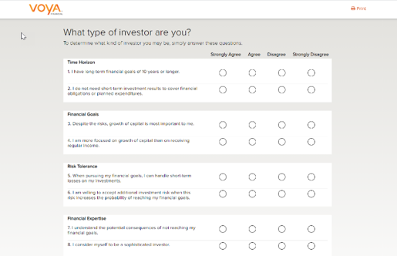

Risk tolerance
Go.Voya.com/Quiz
Notes:
[OPTIONAL – use if client wants more investment selection support.]
One of the ways to help assess your level of risk is use our simple risk tolerance questionnaire by going to ‘Go.Voya.com/Quiz’.
Completing the Risk Tolerance Questionnaire will help you assess your personal willingness or comfort level with investment risk. Based on the answers you provide, you will be associated with a suggested asset allocation model with an investment approach based upon your time horizon, investment objective and tolerance for risk.

Slide 43
Risk vs. return
Global / International
Understand the different levels of risk and reward
Consider a mix of investments from different asset classes
Review and update your strategy at least annually
Small /Mid/ Specialty
Large Cap Growth
Potential Return
Large Cap Value
Balanced
Income
Stability of Principal
Potential Risk
Notes:
[OPTIONAL – use if client wants more investment education content.]
Let’s talk a little bit about risk and return. On this return continuum, you can see in the lower left-hand corner that income type investments such as money market and bonds are low in potential risk, but also low in potential return.
On the other extreme the Global/International asset class is high up on the potential return spectrum, but the risk associated with investing in this asset class has increased dramatically. When invested in this asset class, your investment dollars could benefit dramatically during a market upswing, however it could also decline dramatically during a market downturn.
As a general rule of thumb, and you’ve likely heard this often before, but it bears repeating: The greater the potential risk, the greater the potential reward.
You should always consider your personal risk tolerance when making investment-related decisions. You may wish to consider diversifying your dollars among several asset classes to potentially soften any decreases brought on by downturns in any one particular asset class.

Slide 44
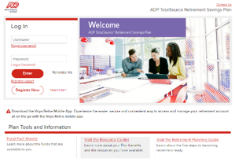

First time login
Scan here to log into your account.
Notes:
[OPTIONAL – use if clients wants to display the registration and pWeb access.]
Accessing your Plan account for the first time on the web or over the phone is easy! You can access your account online by visiting the Associate Portal and logging in with your username and password; then click the Myself tab and select Retirement Plan under Benefits; or go to https://adptotalsource.voya.com and log in with your Social Security number and your Voya-issued PIN.
If you are a new participant, you will receive a Personal Identification Number (PIN) in a separate mailer via U.S. mail. Your PIN is required to access your account by phone or to register for online access.
Don’t worry, if you don’t have your PIN, you can request a PIN online or you can access using your date of birth. There’s a flyer on the Participant Resources website that will walk you through each option step-by-step.
Registering your Plan account online is important. Not only does it help you access tools and resources for your account, but it takes advantage of Voya’s layers of strong online security to help provide protection against the ongoing risk of fraud and cyber threats. To register, click the Register Now…

Slide 45
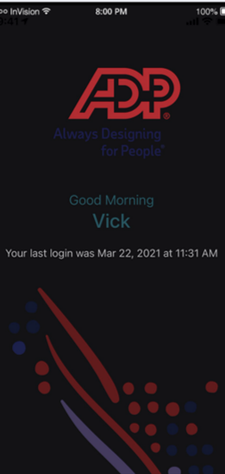


Adp mobile solutions app
Simple, secure, real-time access
Enroll in the plan,
Make a fund transfer,
Change your contribution amount,
Change how your future contributions will be invested,
And more…
Apple, the Apple logo, and iPhone, are trademarks of Apple Inc., registered in the U.S. and other countries. App Store is a service mark of Apple Inc. Android is a trademark of Google LLC and Google Play is a service provided by Google LLC.
Notes:
[OPTIONAL – use if client wants to highlight the ADPTS Mobile app.]
The ADP Mobile Solutions app is a fast and easy way to access your retirement plan account from any mobile device with a few simple clicks.
You can enroll in the plan, change contributions, reallocate your balances, make a fund transfer and much, much, more.
To get started, simply download, and install the ADP Mobile App available from the App Store or Google Play.
Once you have logged on, scroll down to find Retirement/401(k). Now click “View Account” to connect to the Voya participant website.

Slide 46


Enrolling in the plan
Auto enrollment plans
Scan here to VIEW THE VIDEO.
Notes:
[OPTION 1 – SHOW VIDEO]
[NOTE: Auto Enrollment plans]
Please allow me to play this short video describing the enrollment experience. This video is also available withing their Enrollment Kit via email – there is a link to watch this video.
https://presents.voya.com/Content/Delivers/adp/enroll/auto/

Slide 47

Enrolling in the plan
Non-auto enrollment
Scan here to VIEW THE VIDEO.
Notes:
[OPTION 1 – SHOW VIDEO]
[NOTE: Non-Auto Enrollment plans]
Please allow me to play this short video describing the enrollment experience. This video is also available withing their Enrollment Kit via email – there is a link to watch this video.
https://presents.voya.com/Content/Delivers/adp/enroll/non-auto/

Slide 48
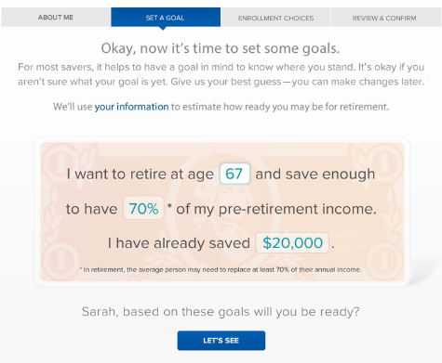
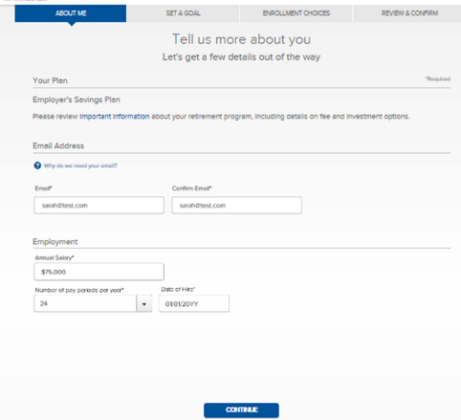
Enrolling in the plan
Step 1 – About me
Step 2 – Set a goal
Notes:
[OPTION 2 – GO OVER SLIDE WITH AUDIENCE]
Enrolling online can be done in 3 simple steps; about me, set a goal and..

Slide 49
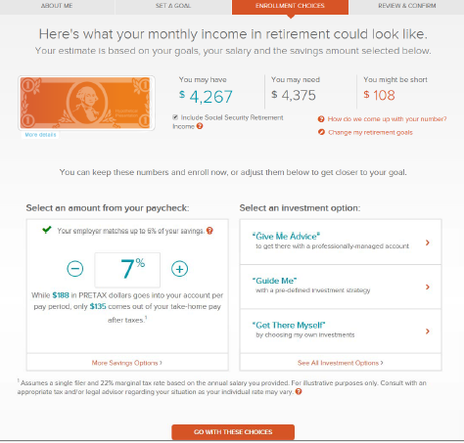
Enrolling in the plan
Step 3 – Enrollment Choices
Contribution type & amount
Investment selection
  Give me advice
  Guide me – Target date funds
  Get there myself – Core funds
Beneficiary selection
Notes:
[OPTION 2 – GO OVER SLIDE WITH AUDIENCE]
Then make your enrollment decisions which include you contribution amount, investment selection and adding beneficiaries.

Slide 50
Designating your beneficiary
1
2
3
Gather the beneficiary’s birth date and Social Security number, as that information is needed to add them to your account.
Log in to your account through the Plan website; from the Personal Information menu, click Beneficiary Information, then click Add/Edit Beneficiary.
Remember to review and update your beneficiaries regularly for life events.
Notes:
[OPTIONAL – use if client wants more to call out beneficiary designation.]
Designating a beneficiary for your ADP TotalSource Retirement Savings Plan account helps make sure that the savings you’ve worked so hard to accumulate are passed to those who you intend to receive this benefit.
Let’s start with who is a beneficiary. It’s the person or organization you select to receive the value of your account in the event of your death. The name you have on file takes priority over legal documents, such as a will. Please note that any beneficiary that you may have designated under a previous plan of your Employer that merges into this Plan will become null and void as of the merger.
You may choose to designate primary and contingent beneficiaries. A contingent beneficiary will receive the funds in the event that your primary beneficiary dies before you. If there are no surviving primary or contingent beneficiaries, death benefits will be paid according to the terms of the Plan.
If you are a married participant (or in a registered domestic partnership relationship), you are generally required to obtain spousal consent if you name a beneficiary other than your spouse (or domestic partner).

Slide 51
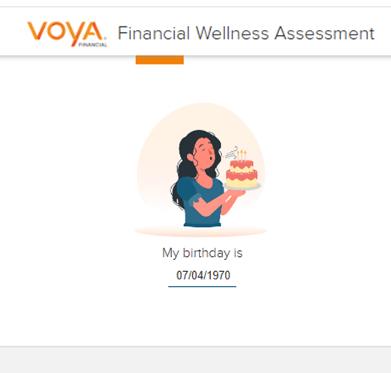

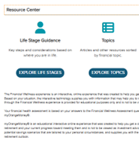
Financial wellness experience
Take the assessment
View your personalized dashboard
Visit the Resource Center
Notes:
[OPTIONAL – MORE DETAIL ABOUT FINANCIAL WELLNESS EXPERIENCE]
This personalized and guided education experience includes three key components:
A brief Financial Wellness Assessment that’s used to score your financial health across six pillars,
A personalized Financial Wellness dashboard, and
A Resource Center which is a centralized home for all educational materials
Once you log into your Plan account, just click the ‘Financial Wellness’ button on the top left part of the page.
The experience starts with a brief series of questions to evaluate your current financial health. After completing the assessment, you will be able to see how you are doing in each of the six pillars.
Your dashboard will be personalized with guidance and educational content targeted to you and your situation.
Within the Resource Center, you have access to additional tools and educational materials to help you achieve your goals.
Throughout the year, go back and re-take the assessment to see how you’re doing to improve your overall financial wellness.

Slide 52


Voya cares®
Helping the special needs community
Education
Voyacares.com/Individuals
1 in 4 Americans
report having a disability.¹
Advocacy and thought leadership
Guiding the way through the planning journey
Voyacares.com/Advocacy
More than 100 million caregivers
  Roughly half of US adults care for a child, parent, or other relative.²
Solutions
Voyacares.com/Employers
1 Disability Impacts All of Us Infographic.” Centers for Disease Control and Prevention, 15 May 2023
  2 Do you see yourself as a caregiver? Guardian Life Insurance, 2023 https://www.guardianlife.com/are-you-a-caregiver.
Notes:
[OPTIONAL – INCLUDE IF EMPLOYER REQUESTS]
The special needs community is the largest minority group in the U.S.
1 in 4 people in the US reports having a disability
Half of US adults care for a child, parent or other relative.
Despite the size of the special needs community, often times their needs are overlooked and underserved
It’s important to note that caregivers also represent an essential group in the special needs community and range from family members to full or part time help and emotional and financial support. Caregivers in the workforce face particular challenges, juggling work and caregiving responsibilities as well as battling stereotypes or social stigmas.
90% of caregiver employees feel they lack company support in areas.
64% [of family caregivers] reported that caregiving impacted their career, due to having to take time off, conflicts with scheduling, using office hours to get non-work items done, having to quit a job, missing meetings, using office resources for non-work items or even sidelining a career advancement opportunity. (The Impact of Caregiving on Work. A National Business Group on Health® Publication, 201: https://www.businessgrouphealth.org/pub/?id=2F661FB2-E990-8924-0120-D3733FD60E90. )
94% of caregivers would stay with employers that provide relevant caregiving benefits/resources.
Voya Cares® provides education, resources, and access to personalized support for people with disabilities and their caregivers. (“For the Benefit of All: How Organizations Win When They Recognize and Support Caregivers and Employees with Disabilities”, Voya Financial, May 2019, voyacares.com/forthebenefitofall.)
Whether you’ve started planning or don’t know where to begin, Voya can help you navigate your next step.
Education – Serve as resource navigators, providing one-stop access to information and personalized solutions.
Personalization – Personalized online resources factor in your unique needs.
Understanding – Help you understand the benefits available based on your circumstances.
We are committed to making a positive difference in the lives of people with disabilities and special needs from birth through aging, by providing advocacy, resources and solutions.

Slide 53
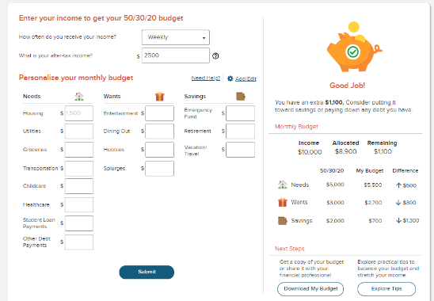

Online budgeting tools
Scan here to learn more.
Notes:
[OPTIONAL – use in wants to promote the budget tool.]
Setting up a budget is fairly straightforward. At Voya, we have a new online Budget Calculator to help you get started. It’s easy to use and can help you created a personalized budget for your needs, wants and savings. Additionally, you’ll also have the ability to download a pdf or excel file of your budget and access to practical tips to help you stretch your income.
Direct link - https://www.voya.com/tool/budget-calculator

